Slide 1
Intro to Digital Forensics:
By Miguel Lopez
Notes:
Good Afternoon,

Slide 2
Who am I?
BSc Cyber Security at University of Warwick
https://www.linkedin.com/in/miguellopezg/
https://github.com/mg-lopez

Slide 3
Contents
What is Digital Forensics?
Use cases
File Types & Metadata
Case Study
Conclusions

Slide 4

What is
Digital Forensics?
“Digital Forensics is about examining hidden data in files”
Notes:
Crutial in legal proceedings, helps legal institutions by examining … using static and dynamic analysis.
In an incident response context, digital forensics enables originations to identify the scope and impact of the breach
Determine the root cause and implement remediation measures
By analysing the digital artifcats using tools such as Autopsy, it enables orgnisations to discover threat actors TTPs

Slide 5
Forencics use cases:
01
02
File Analysis
Steganography
03
04
Memory Analysis
Network Analysis
Recover deleted files within hard drives, media devices or browser data.
Uncover hidden data embeded within files
Examining disk images, live memory dumps.
Looking into network traffic through packet captures.

Slide 6

02
Stenography
“The art of Concealing information within other data to avoid detection” – incl. hiding data within images, audio, PDF, ZIP files.
Notes:
- Inclu

Slide 7
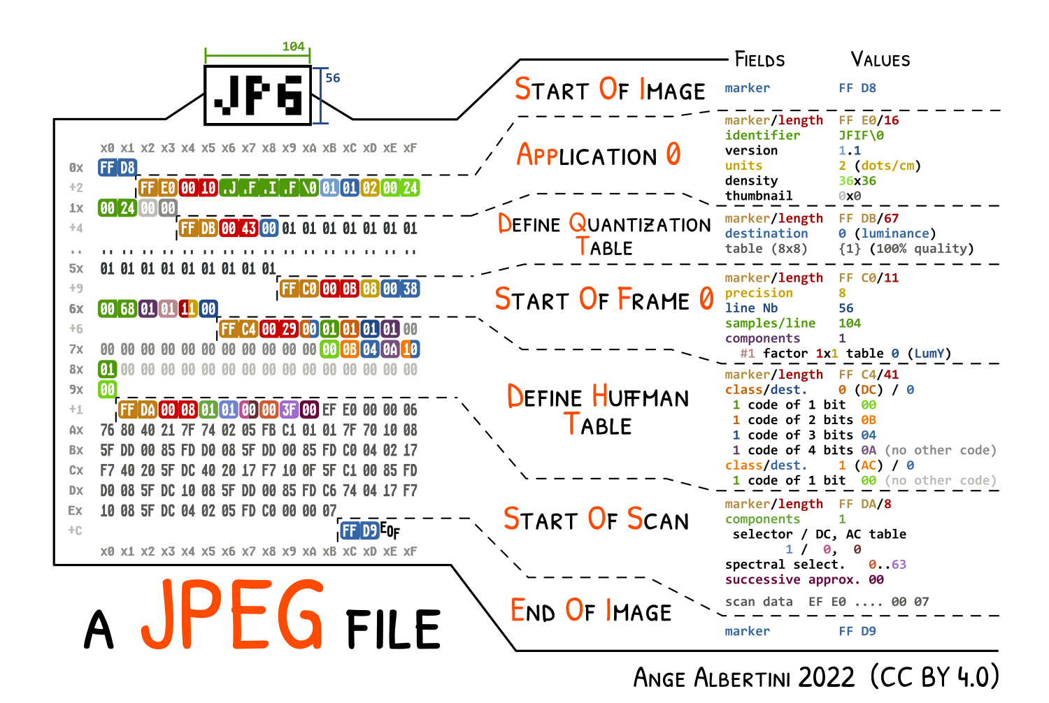
Notes:
File header of an image
First 2 bytes indicates that it is indeed a picture,
An attacker can modify these two bytes to try minimic another file type

Slide 8
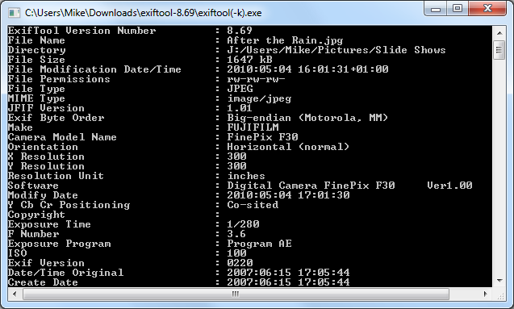
Speaking of files… what’s metadata?
“provides information about a file” - i.e. where an image was taken, what camera it was taken on, etc.

Slide 9
Case Study
Scenario:
“A threat actor is planning a terrorist attack; intelligence has discovered a social media channel containing only images. They have just posted a new picture, which we believe it contains the location of the attack. Can you help us uncover their plans?”

Slide 10

Image Intercepted

Slide 11
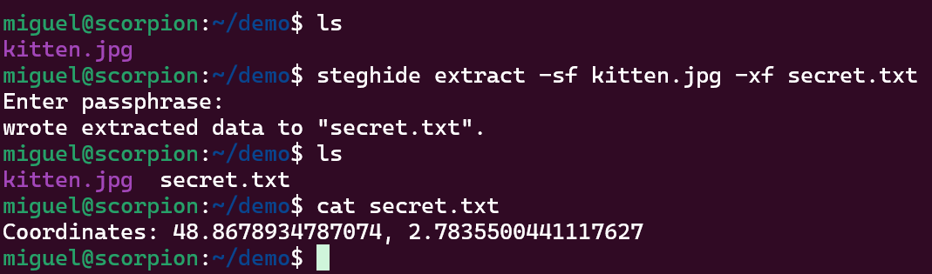
Data Exfiltration

Slide 12
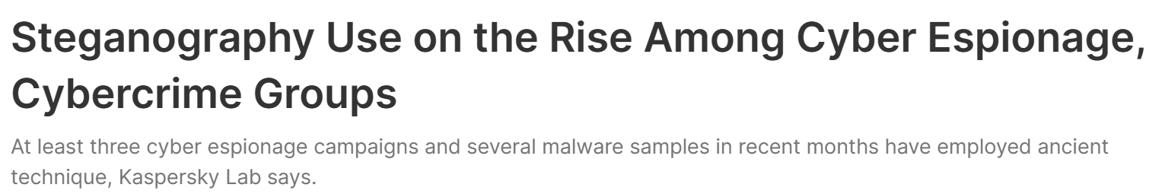
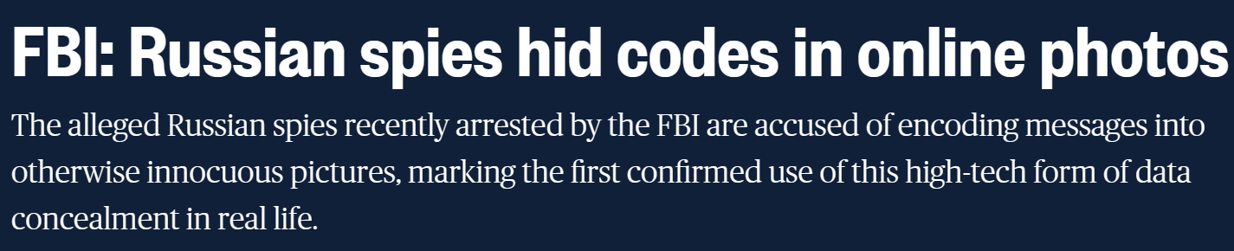
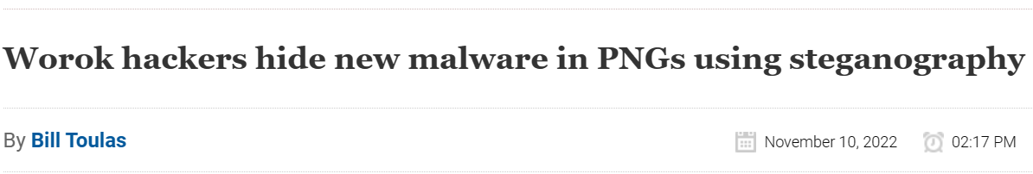
Relevance?

Slide 13
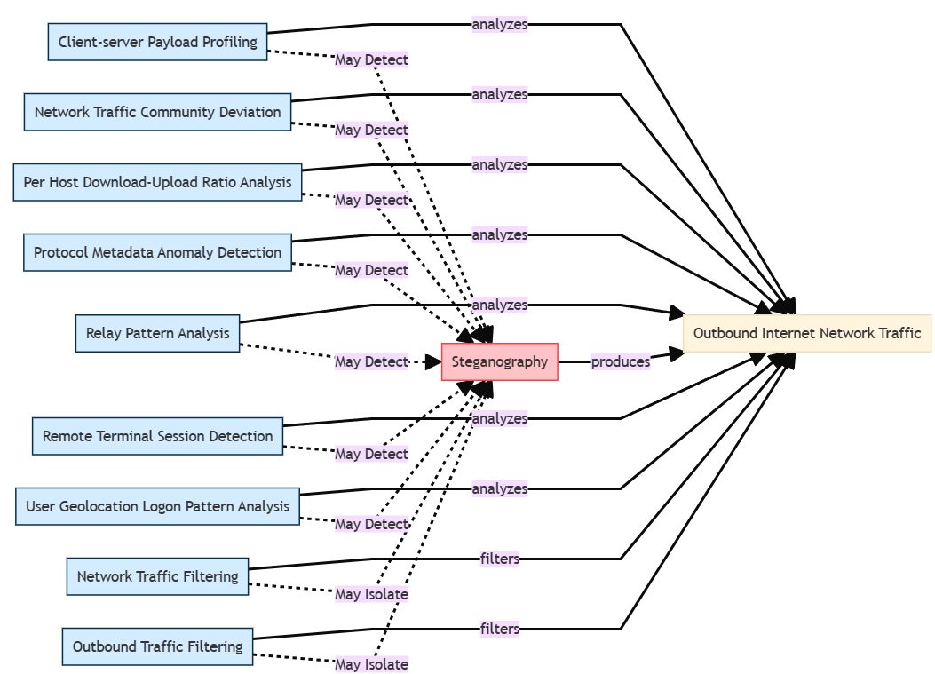
Mitigations

Slide 14
Thank you for listening!
Questions?

Slide 15
Resources
https://youtu.be/XO6737KLaTg
Steganography Use on the Rise Among Cyber Espionage, Cybercrime Groups (darkreading.com)
Data Obfuscation: Steganography, Sub-technique T1001.002 - Enterprise | MITRE ATT&CK®

